Slide 1
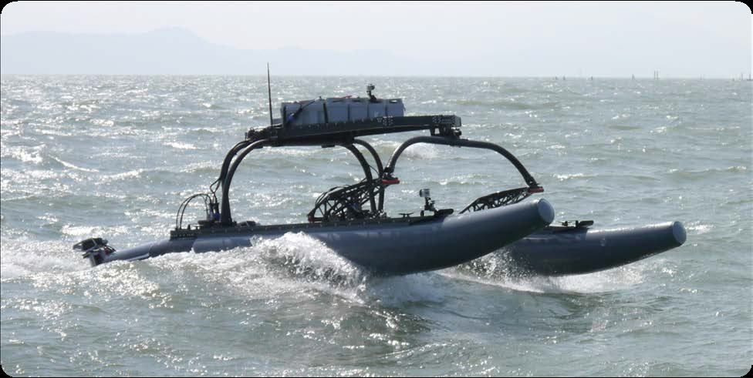
RobotX Vision

Slide 2
“What is around me?”
Identify known buoys in (3) dimensions
Discover and avoid unknown objects in (3) dimensions
Find known targets
Determine location and frequency of illuminated buoys

Slide 3
Three Cameras Concept
Forward Looking with 360 degree pan
Starboard Looking Fixed
Port Looking Fixed

Slide 4
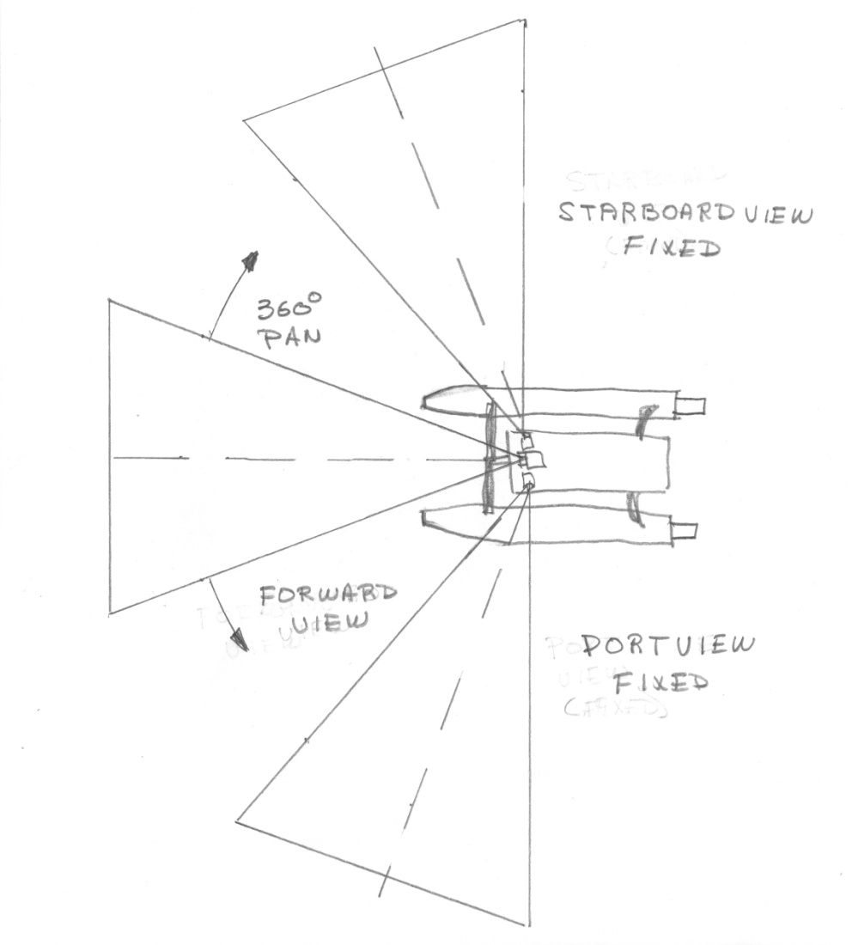
Top View Sketch

Slide 5
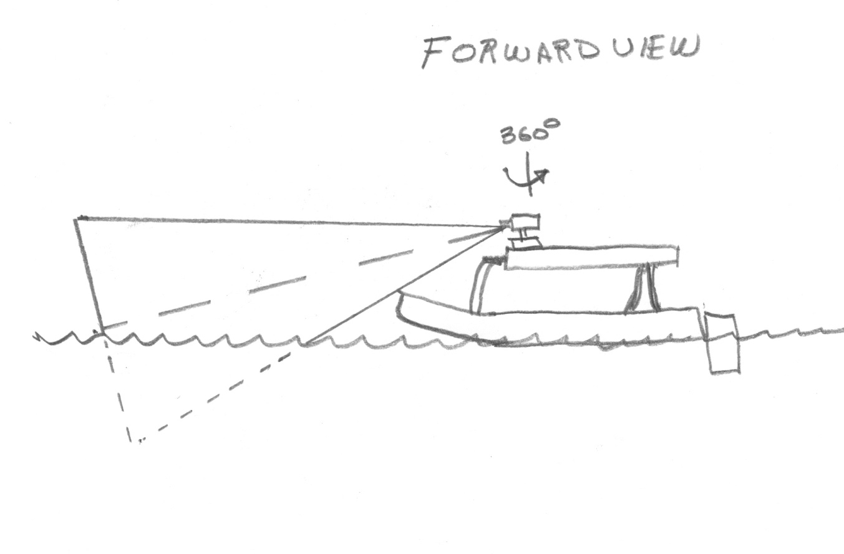
Port View Sketch

Slide 6
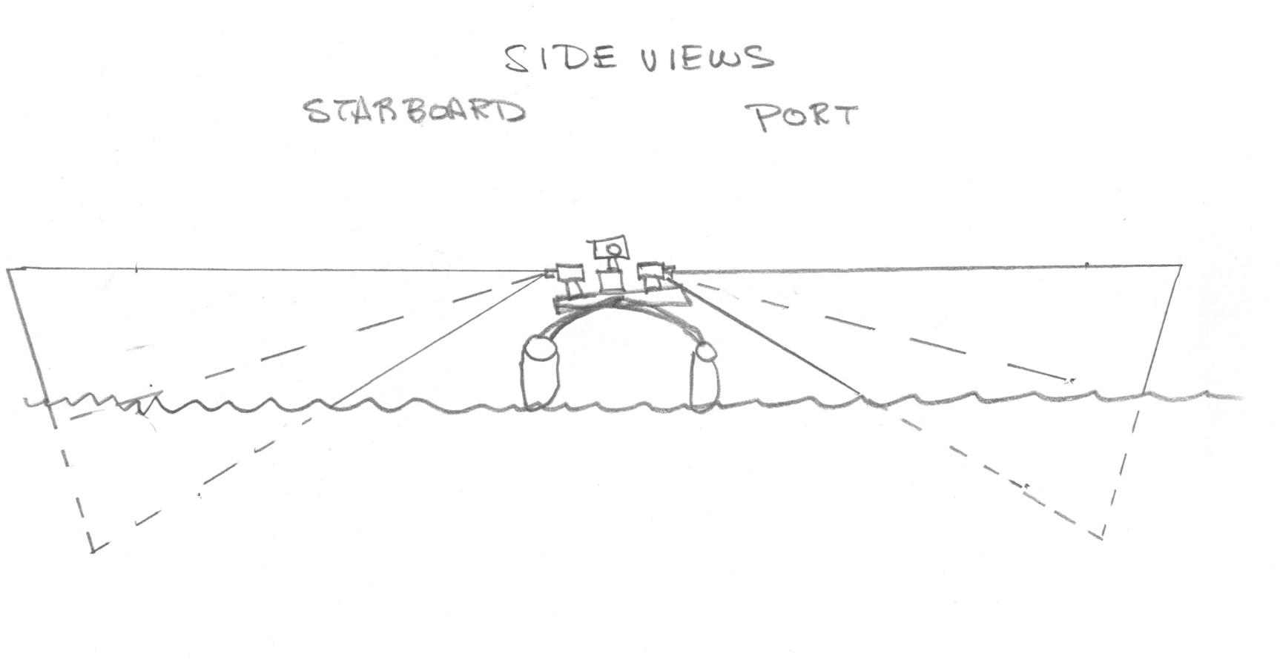
Bow View Sketch

Slide 7
Vision System Concept
Flea3
National Instruments
CVS 1457 Real-Time
Compact Vision and LX25 FPGA
System for GigE Cameras
Pan
Flea3
switch
Flea3
Pitch
Roll

Slide 8
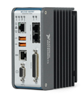
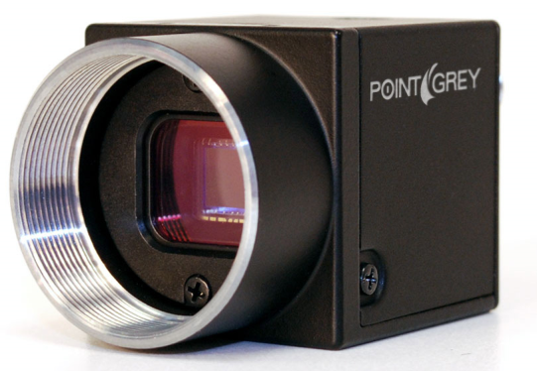
Vision System and GigE Camera

Slide 9
Initial System Concept
To Forebrain
Occipital Lobe
switch
Hindbrain and Midbrain
National Instruments
CVS 1457 Real-Time
Compact Vision and LX25 FPGA
System for GigE Cameras
National Instruments cRio
Integrated Real-Time Controller
and LX45 FPGA
High Speed
Data Link
Compass / GPS
Motors
Boat Speed
Steering

Slide 10
Assumptions
Average boat speed of 2 M/sec (4.5 MPH)
Max boat speed of 5 M/sec (11 MPH)
Daylight operation only
Boat pitch and roll under +/- 10 Degrees, 3/4 M seas

